Slide 1

SCRIPTS AND FUNCTIONS
DAVID COOPER
SUMMER 2014

Slide 2
Extensions
MATLAB has two main extension types .m for functions and scripts and .mat for variable save files.
To edit files MATLAB contains a built in Editor which will help interpret MATLAB code in real time.
Different code types will be different colors
  >> normal code
  >> keyword
  >> ‘string’
  >> % comment
Parsing errors will be highlighted in real time with the red squiggly underline while warnings will be highlighted with a golden squiggly line

Slide 3
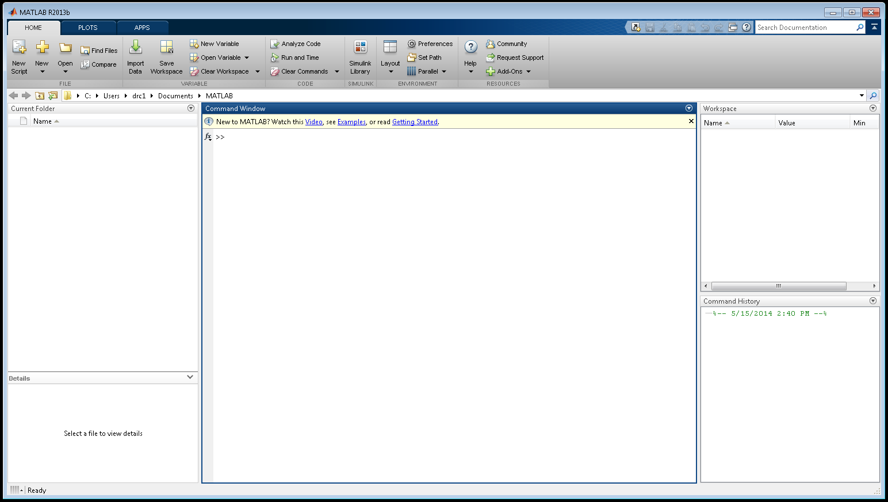
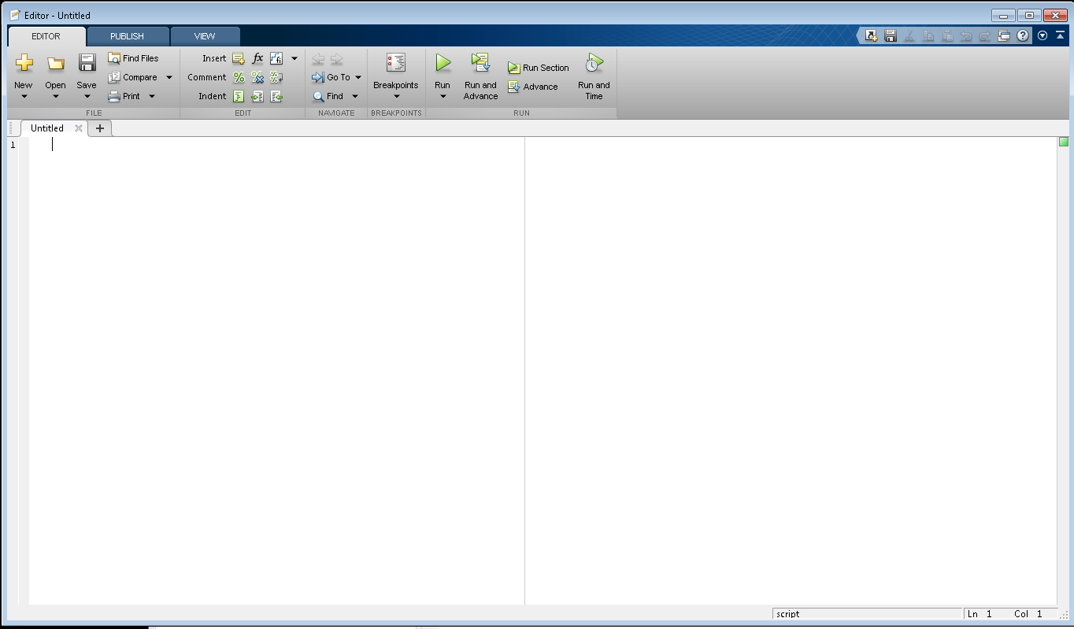
MATLAB Screen

Slide 4
Scripts
Scripts allow for complex series of commands to be run simultaneously one after the other.
Useful for calculating and manipulating data
Running the script will act as if you have entered every line in order into the command window, complete with unsuppressed responses
Nonparsing errors will also appear along with the line where they occurred

Slide 5
Functions
Function: Prewritten code that takes in inputs performs operations and then returns an output
As we have seen MATLAB has a number of built in functions but you can also create you own
Custom functions need to be saved with the same name as the function call
Custom functions can only be run if they are in the current directory or one of the default directories for MATLAB

Slide 6
Directory Management
To see what your current directory is use the cd function
  >> cd
  C:\Windows\system32
Your current directory can be managed by directly changing the file location
cd can also be used to set the directory
  >> cd(‘C:\Users\Owner\Documents\ItM’)

Slide 7
Function Syntax
The first evaluated line in a function must be the function call
  function [output1,output2,…] = FunctionName(input1,input2,…)
You may have any number of inputs and outputs for a function but every output must be defined before the end of the function
The final evaluated line should be the end keyword for every function

Slide 8
Subfunctions
Only the first function in a function script can be called from outside of the function. This is because the filename is the same as the function
However for complicated functions you may want to have a repetitive task be relegated to a subfunction.
Subfunctions work just like a normal function in terms of syntax and you can have as many as you need.

Slide 9
Conditional Statements
When creating functions you may only want to run certain section given a certain circumstances
If statements help to accomplish this based on a conditional operator
  >> if a == 2
  b = 3;
  end
There are 6 main conditional operators; ==, ~=, <, >, <=, >=
If statements must be terminated with end just like functions
To add additional conditions use else and elseif

Slide 10
Loops
Loop: a repeated operation that ends depending on the type and a given circumstance
The two main loop types are for loops and while loops
For loops run for a set duration determined by the input variables
  >> for n = 1:100
  b = n^2;
  end
While loops will run until their conditional statement is met
  >> while a <= 29
  a = a+3;
  end
Loops must be terminated with end

Slide 11
Commenting
For any script that you create, commenting is one of the most important things you can do.
MATLAB Comments begin with the % sign
  >> % Anything written after this will be a comment
  >> % Comments show up highlighted in green and are not evaluated
Comments are important as they help to explain what is going on
A double %% on its own line will also create sections inside a user generated script

Slide 12
Commenting
A comment can also be added after code that is to be evaluated
  >> area = pi*2^2 % pi is a pregenerated variable equal to 3.1416
  area =
  12.5664
For most scripts the best practice is to use comment block for the first couple of lines detailing who wrote the script, when it was written and a brief description. The editor will automatically move the comment to a new line and auto comment if the description is long enough
1 %%%%
2 % Example Script
3 % David Cooper
4 % 7/9/14
5 %
6 % This is an example script created for the introduction to MATLAB course
7 % it shows sever examples of useful function as well as some of the
8 % prebuilt features for MATLAB code.
9 %%%%
10

Slide 13
Structures
Structures are organizational variables for storing other variables
Structures can be initialized by assigning a variable to be equal to struct
  >> StructureExample = struct
  StructureExample =
  struct with no fields.
Variables can be added to structs by delimitating with a period
  >> StructureExample.first = 1
  StructureExample =
  first: 1

Slide 14
Saving
Structures are useful for saving large numbers of variables easily
The save() function will save your entire workspace or specific variables
  >> save(‘filename.mat’)
  >> save(‘filename.mat’, struct)
Save filenames must have the extension .mat
Using the load() function will load a .mat file into the current workspace. If you assign a variable then MATLAB will create a struct with the fields equal to the loaded variables
  >> load(‘filename.mat’)
  >> LoadedData = load(‘filename.mat’)

Slide 15
Useful Functions
The numel() function is useful for determining the number of elements in a matrix or vector
  >> A = [1 2 3;4 5 6;7 8 9];
  >> numel(A)
  ans =
  9
The sum() function will sum up all of the elements along a single dimension.
  >> sum(A)
  ans =
  12 15 18
  >> sum(sum(A))
  ans =
  45

Slide 16
Random Distributions
There exist several useful random distributions that you may want to use.
A uniform distribution involve an equal chance at existing at any of the numbers in the interval
  >> rand(n,m)
  >> unifrnd(a,b,n,m)
A normal distribution observes the standard Gaussian curve with a mean and a standard deviation
  >> randn(n,m)
  >> normrnd(mu,sig,n,m)
The second function for random is only available with the statistics toolbox

Slide 17
Averages
MATLAB also has a number of built in functions for calculating averages. They work just like the sum() function in that the work one dimension at a time
  >> mean(A) >> median(A)
  ans = ans =
  4 5 6 2
  5
  8
You can also calculate the standard deviation similarly
  >> std(A)
  ans =
  3 3 3
In order to calculate the average values for all of the elements simultaneously you must reshape the matrix into a vector

Slide 18
Min and Max
MATLAB has built in functions to find the minimum and maximum for vectors and matrices
  >> max(A) >> min(A,[],2)
  ans = ans =
  7 8 9 1
  4
  7
These functions can also be used to compare the elements to a specific number using the second input
Min and max also have a second output that can be found by using a vector variable that contains the index for the corresponding return value
  >> [val, ind] = max(eye(3))
  val =
  1 1 1
  ind =
  1 2 3

Slide 19
Rounding
The round function will round a number or array to the nearest integer value
  >> B = [2.6 7.54; 3.311 4.0];
  >> round(B)
  ans =
  3 8
  3 4
  To get a specific decimal place you must multiply the matrix by the power of 10 then divide the round answer by the same factor
  >> round(B*10)./10
  ans =
  2.6000 7.5000
  3.3000 4.0000
There is not a prebuilt function to do this otherwise but you can overwrite the round function to add this capability

Slide 20
Getting Help
The help command allows you to get the MATLAB documentation for any function. It will also return a comment block from a custom function
Visiting www.mathworks.com/help/matlab will give you the same information as in the help files but may be easier to navigate
Often someone else has tried the same thing you are. The MathWorks forums and file exchange will have community created functions that you can download and use
Google is your friend. Typing ‘matlab’ plus whatever you are trying to do will often lead you strait to the related MATLAB function

